Slide 1


Chatterbox: A Real-Time WebSocket Chat Application
Building a highly concurrent, bi-directional chat system that scales to thousands of users with persistent connections and instant message delivery.
Notes:
1

Slide 2
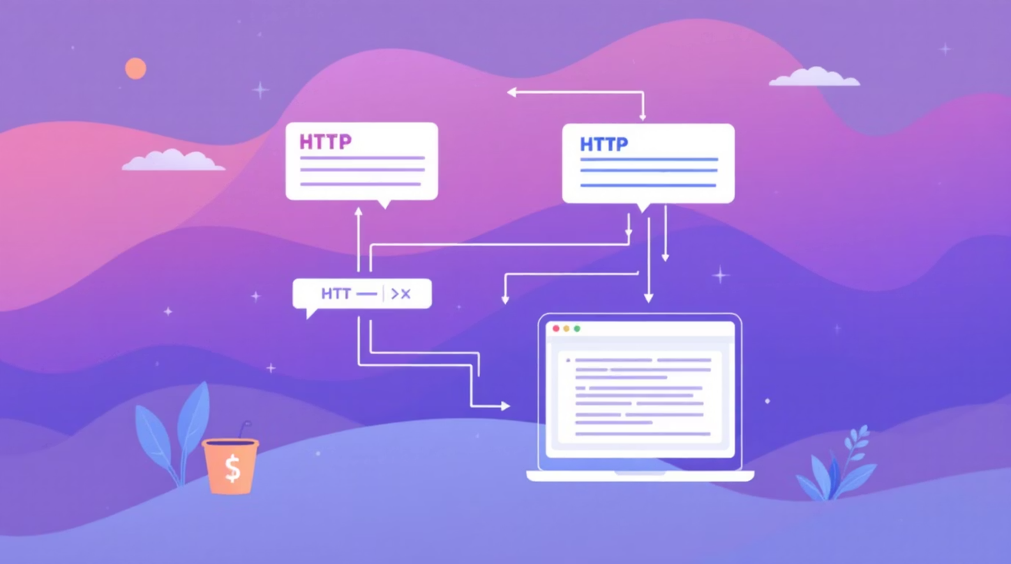
The Challenge of Real-Time Communication
Traditional Request-Response Limitations
Conventional HTTP architectures establish a new connection for each request, creating latency and preventing persistent, bi-directional communication needed for real-time applications.
Each request requires TCP handshake
Server cannot push updates to clients
High overhead for frequent updates
Firewall and NAT traversal complications
Notes:
2

Slide 3
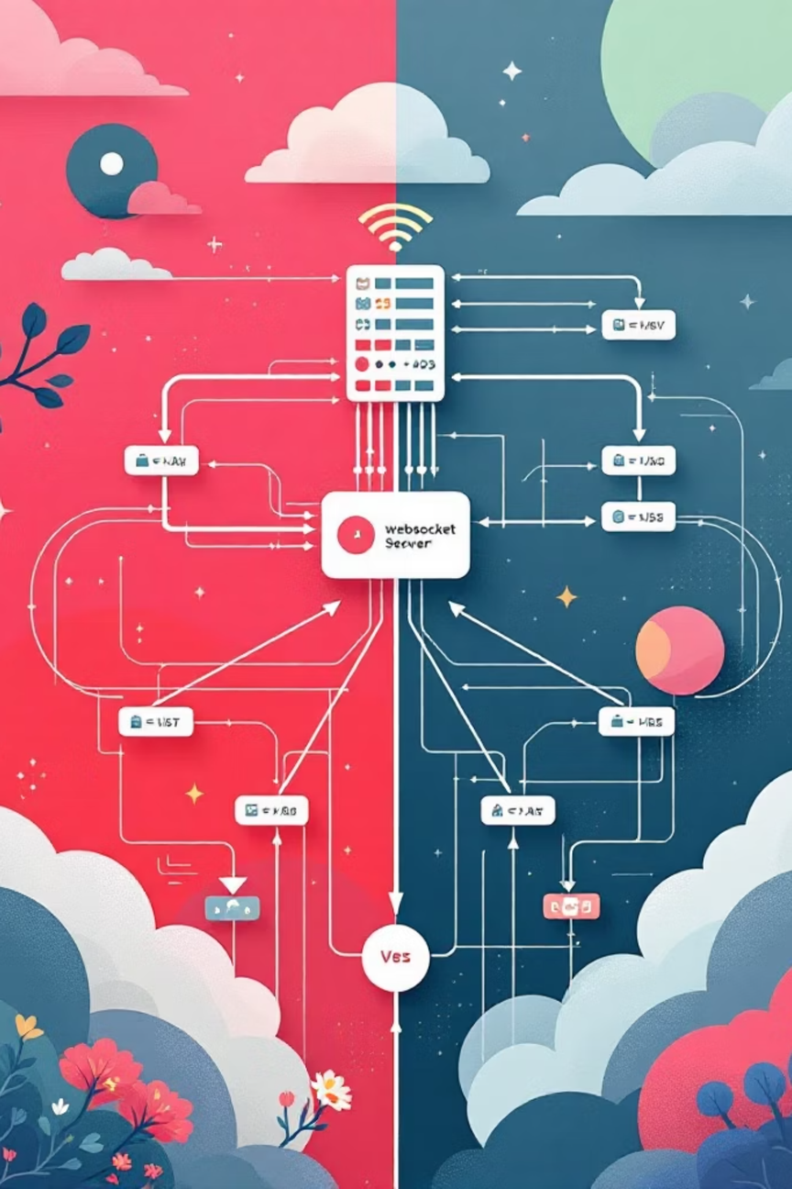




Enter WebSockets: Persistent Bi-Directional Communication
Persistent Connection
Bi-Directional Flow
Single TCP connection stays open, eliminating repeated handshakes and reducing latency significantly.
Both server and client can send messages independently without waiting for requests from the other end.
Low Overhead
Minimal framing overhead compared to HTTP headers, allowing efficient, high-frequency message transmission.
Notes:
3

Slide 4
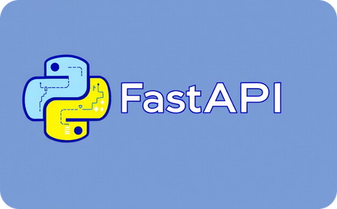



Technology Stack
FastAPI Backend
WebSocket Protocol
PostgreSQL
Terminal Client
Async Python framework for building high-performance WebSocket endpoints with automatic API documentation and type hints.
Persistent connection handling and pub-sub messaging patterns for real-time broadcasting to all connected clients.
Relational database storing user accounts, authentication credentials, and complete chat history with ACID compliance.
Interactive command-line interface written in Python for connecting, sending messages, and receiving real-time broadcasts.
Notes:
4

Slide 5
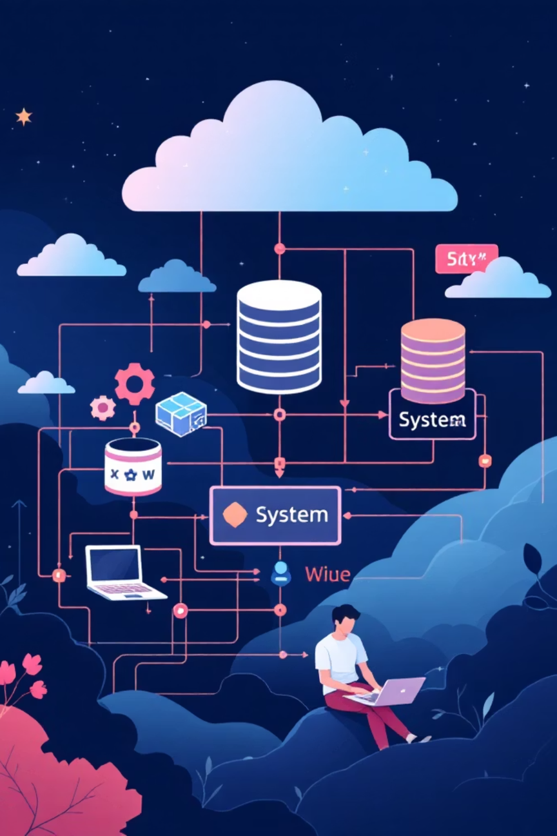



System Architecture Overview
Authentication Layer
Handles user registration, login, and session management. Validates credentials and creates secure sessions.
WebSocket Manager
Central hub managing all connections, tracking active users, and broadcasting messages to subscribers.
Data Storage
Persists chat history, user profiles, and metadata for retrieval and audit purposes.
Notes:
5

Slide 6

WebSocket Manager: The Heart of the System
Core Responsibilities
The manager orchestrates the entire real-time experience, efficiently routing messages and maintaining connection state across thousands of concurrent users.
Connection Management
Message Broadcasting
Pub-Sub Pattern
Tracks all active WebSocket connections, handles new connections, and gracefully closes stale sessions.
Receives messages from any client and instantly relays them to all connected participants in the chat room.
Implements publish-subscribe model where clients subscribe to channels and publisher broadcasts to relevant subscribers.
Notes:
6

Slide 7




Client-Server Interaction Flow
Connection
Client establishes WebSocket connection to server endpoint, transmitting authentication credentials via headers or initial message.
Authentication
Server validates user credentials, creates session record, and returns success response or error message.
Subscription
Client subscribes to chat room channels it wants to receive messages from, joining the broadcast group.
Chat
Messages typed by user are sent to server, which logs to database and broadcasts to all subscribers instantly.
Disconnection
When client closes connection, server removes session, unregisters from broadcast groups, and marks session as expired.
Notes:
7

Slide 8





Key Technical Features
Asynchronous Processing
Secure Authentication
Message Persistence
Input Validation
Non-blocking I/O using asyncio enables handling thousands of concurrent connections on a single server instance through cooperative multitasking.
JWT tokens for session management, password hashing with bcrypt, HTTPS/TLS encryption for all WebSocket connections.
Complete chat history stored in database with timestamps, user references, and message content for retrieval and auditing.
Sanitises all incoming messages, validates data structure, and prevents injection attacks through strict type checking.
Rate Limiting
Multi-Room Support
Prevents abuse by limiting message frequency per user, protecting against denial-of-service attacks and spam.
Users can join multiple chat rooms simultaneously, each with independent access controls and message broadcasting.
Notes:
8

Slide 9








Conclusion & Future Enhancements
Achievements
Future Roadmap
Message History API
Scalable WebSocket implementation
Retrieve past conversations with pagination and search functionality
Handles thousands of concurrent connections efficiently using async architecture
User Presence Tracking
Show online/offline status and last seen timestamps for contact list
Real broadcast capability
Private Messaging
Messages delivered to all participants within milliseconds
One-to-one encrypted conversations outside public chat rooms
Horizontal Scaling
Production-ready features
Distributed deployment across multiple servers with message broker integration
Authentication, persistence, security, and input validation
Minimal client overhead
Lightweight terminal interface for testing and validation
Notes:
9

